Slide 1

Passwordless Apps with WebAuthN and Passkeys
By
Shashank Kaushik

Slide 2
Agenda
Intro to WebAuthn
Intro to Passkeys
Steps of WebAuthn in Swift
iOS Implementation
WebAuthn Setup
Challenges

Slide 3
Current Security Threats
Service Provider compromised (Password leaks)
Phishing
Maintain different passwords
Reuse passwords
Store passwords in DB
Password is a share secret hence high risk of vulnerability

Slide 4
Intro to WebAuthn

Slide 5
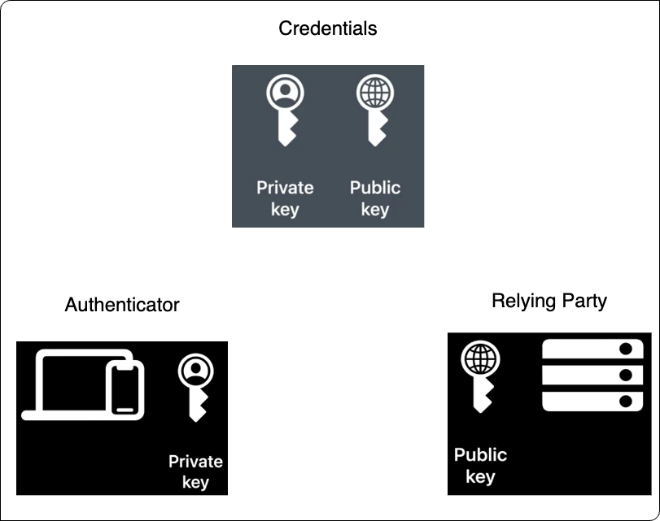
Public key cryptography
Private key is stored safely with the user
Public key is shared with the server
Notes:
The API allows servers to register and authenticate users using public key cryptography instead of a password.
A public key + randomly generated credential id is sent to server for storage. The public key is not secret and hence there is no information security risk at server or database side
The public key is not secret, because it is effectively useless without the corresponding private key. The fact that the server receives no secret has far-reaching implications for the security of users and organizations. Databases are no longer as attractive to hackers, because the public keys aren’t useful to them.

Slide 6
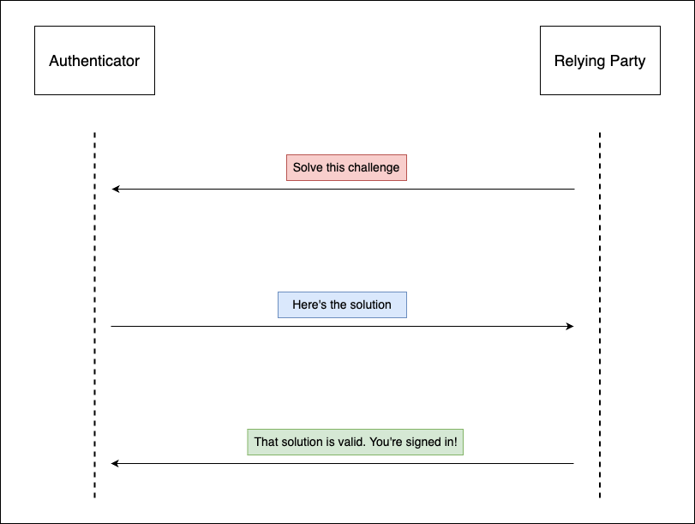

Slide 7
Major Properties
Strong – Safely store private keys and perform cryptographic operations
Scoped – keypair is only be used at specific origin
Attested – Authenticator provide certificate that helps servers verify that it comes from authenticator they trust.
Notes:
Strong
Authentication is ideally backed by a Hardware Security Module, which can safely store private keys and perform the cryptographic operations needed for WebAuthn.
Scoped
A keypair is only useful for a specific origin, like browser cookies. A keypair registered at 'webauthn.guide' cannot be used at 'evil-webauthn.guide', mitigating the threat of phishing.
MITM not possible
Password reuse not possible
Attested
Authenticators can provide a certificate that helps servers verify that the public key did in fact come from an authenticator they trust, and not a fraudulent source.

Slide 8
Intro to Passkeys
Eliminate passwords.
Rely on Biometric Identification
Way of expressing WebAuthn by Apple by adding additional layer of backing private key into iCloud keychain

Slide 9
Steps of WebAuthn in swift

Slide 10
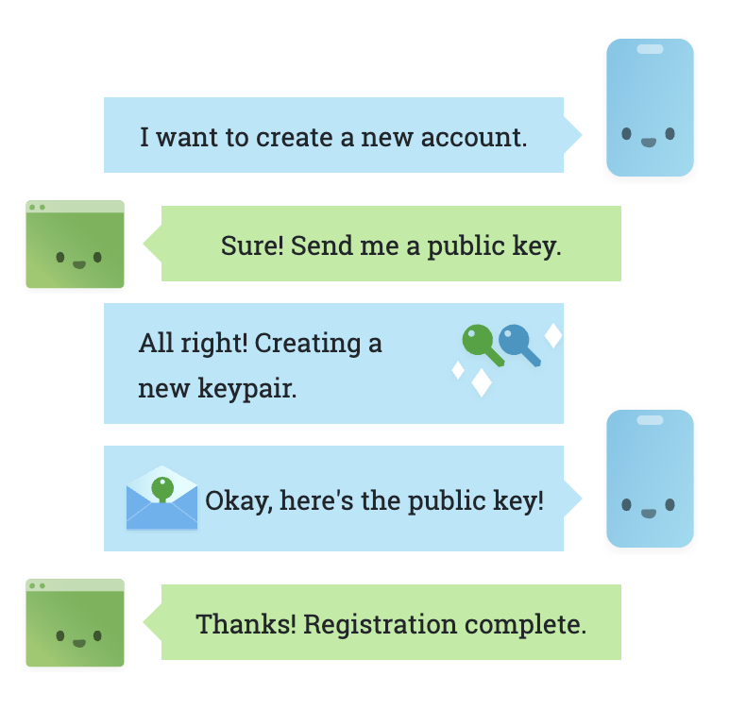
Sign up

Slide 11
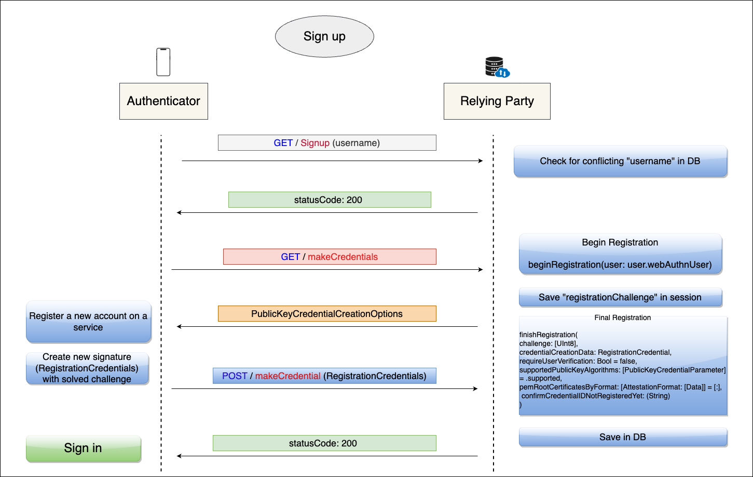
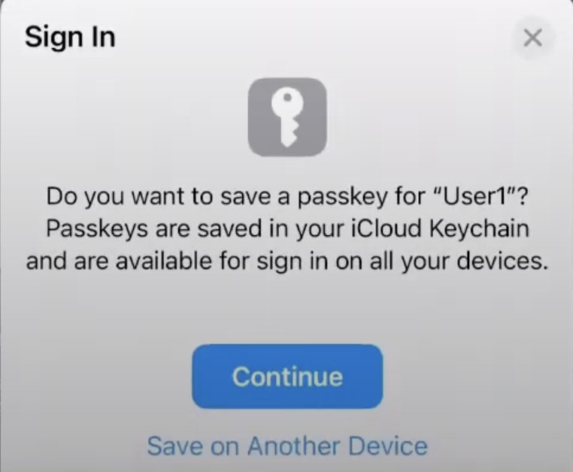

Slide 12
PublicKeyCredentialCreationOptions
Challenge: buffer of cryptographically random bytes generated on the server, and is needed to prevent "replay attacks"
Rp: This stands for “relying party”; it can be considered as describing the organization responsible for registering and authenticating the user. The id must be a subset of the domain currently in the browser.
User: This is information about the user currently registering. The authenticator uses the id to associate a credential with the user
PubKeyCredParams: This is an array of objects describing what public key types are acceptable to a server.
AuthenticatorSelection: optional object helps relying parties make further restrictions on the type of authenticators allowed for registration
Timeout: time (in milliseconds) that the user has to respond to a prompt for registration before an error is returned.
Attestation: The attestation data that is returned from the authenticator has information that could be used to track users. This option allows servers to indicate how important the attestation data is to this registration event. A value of "none" indicates that the server does not care about attestation

Slide 13
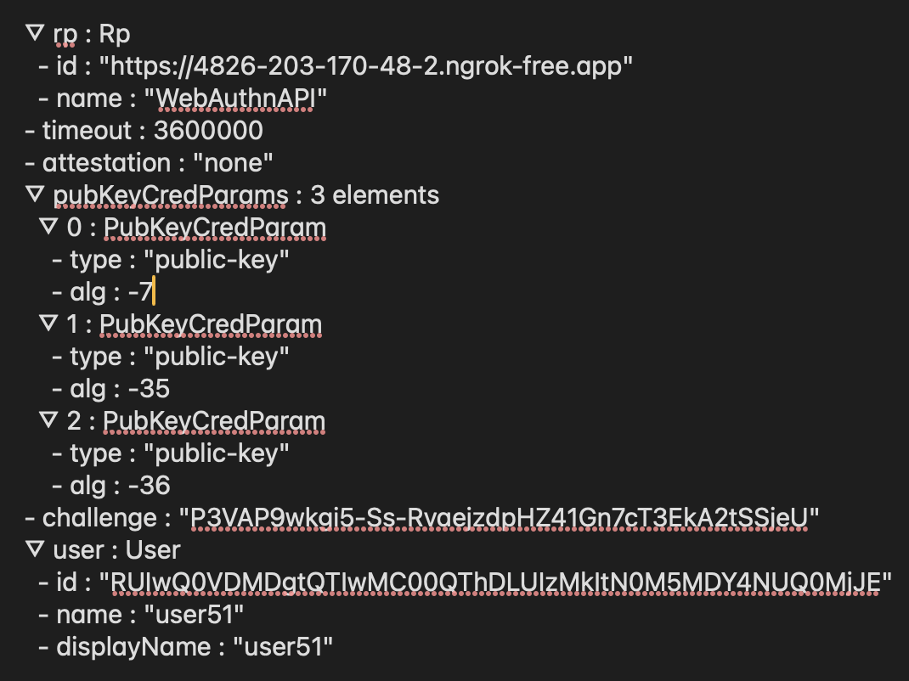

Slide 14
RegistrationCredential
Id: The ID for the newly generated credential; it will be used to identify the credential when authenticating the user. The ID is provided here as a base64-encoded string
rawId: The ID again, but in binary form
Type: The server validates that this string is in fact "webauthn.create". If another string is provided, it indicates that the authenticator performed an incorrect operation.
attestationResponse: AuthenticatorAttestationResponse(clientDataJSON, attestationObject)
clientDataJSON: This represents data passed from the browser to the authenticator in order to associate the new credential with the server and browser.
attestationObject: This object contains the credential public key, an optional attestation certificate, and other metadata used also to validate the registration event.

Slide 15
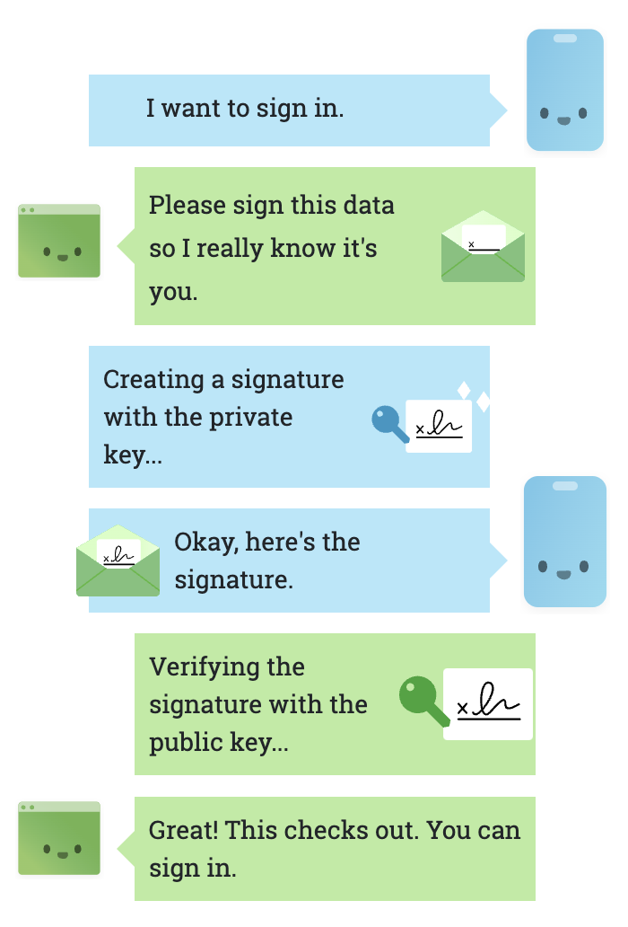
Sign in

Slide 16
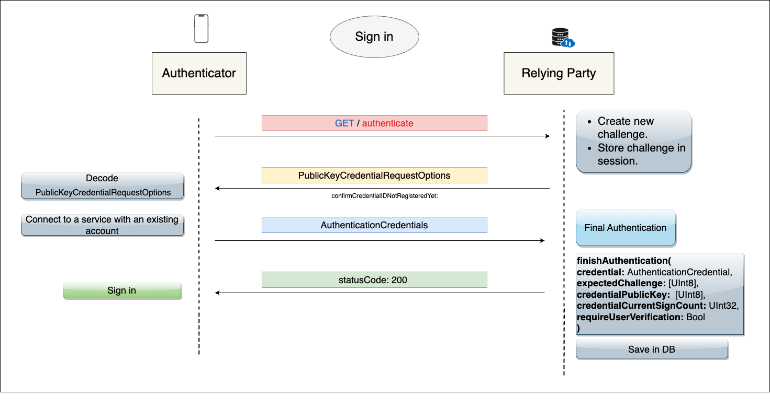
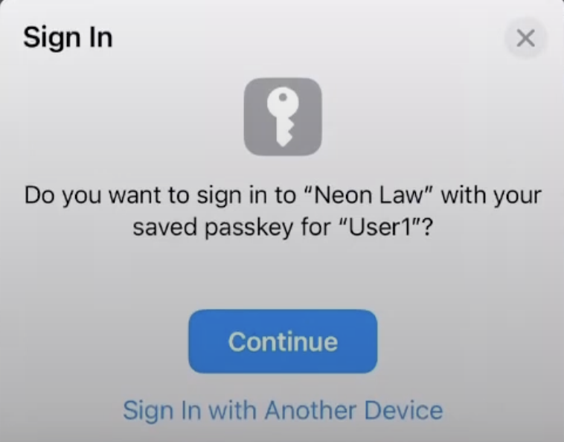

Slide 17
PublicKeyCredentialRequestOptions
challenge: Like during registration, this must be cryptographically random bytes generated on the server.
allowCredentials: This array tells the browser which credentials the server would like the user to authenticate with. The credentialId retrieved and saved during registration is passed in here
timeout: Like during registration, this optionally indicates the time (in milliseconds) that the user has to respond to a prompt for authentication.

Slide 18
AuthenticationCredential
id: The identifier for the credential that was used to generate the authentication assertion.
rawId: The identifier again, but in binary form.
authenticatorData: The authenticator data is similar to the authData received during registration, with the notable exception that the public key is not included here. It is another item used during authentication as source bytes to generate the assertion signature
clientDataJSON: As during registration, the clientDataJSON is a collection of the data passed from the browser to the authenticator. It is one of the items used during authentication as the source bytes to generate the signature
signature: The signature generated by the private key associated with this credential. On the server, the public key will be used to verify that this signature is valid.
userHandle: This field is optionally provided by the authenticator, and represents the user.id that was supplied during registration. It can be used to relate this assertion to the user on the server.

Slide 19
iOS implementation

Slide 20
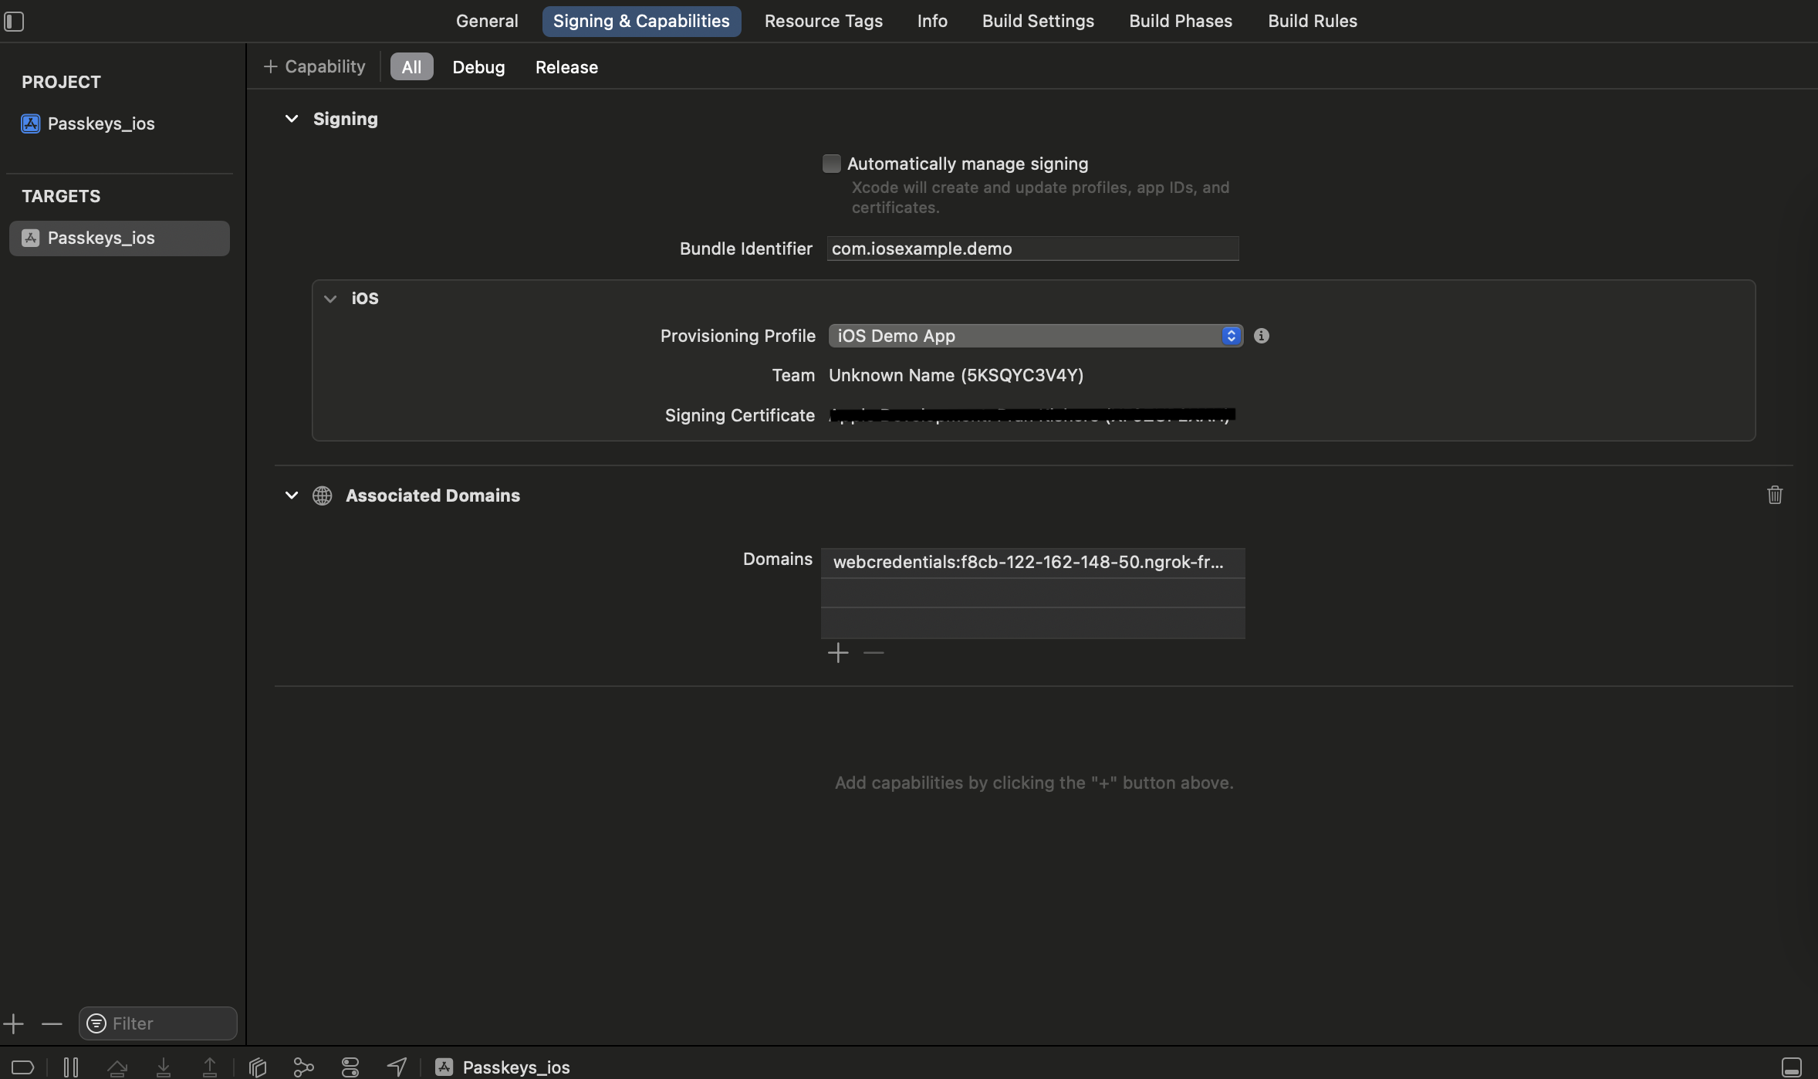
Associated Domains

Slide 21
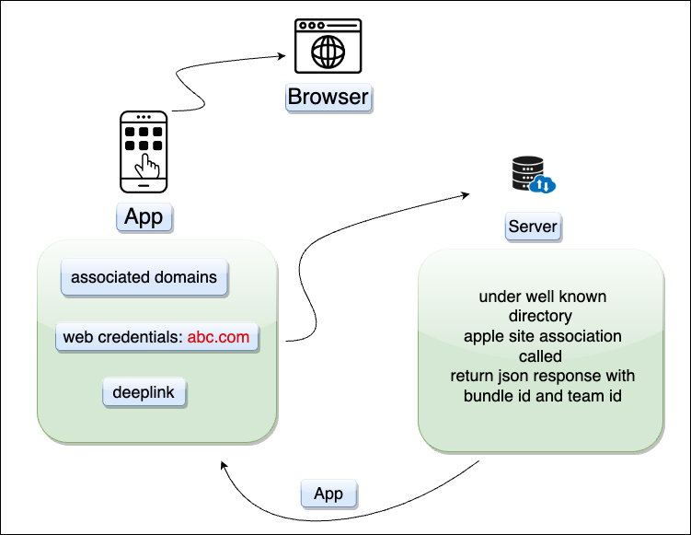

Slide 22
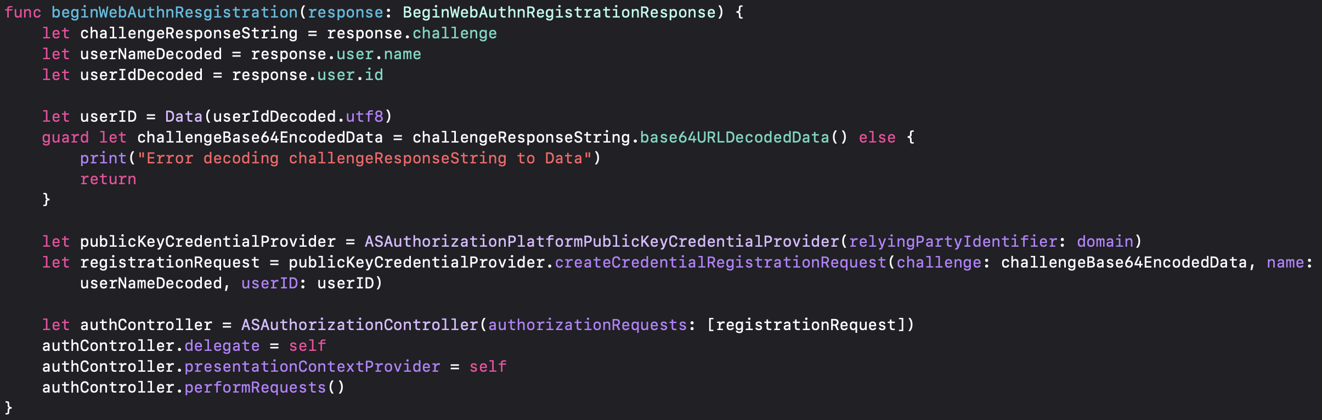
Registration

Slide 23
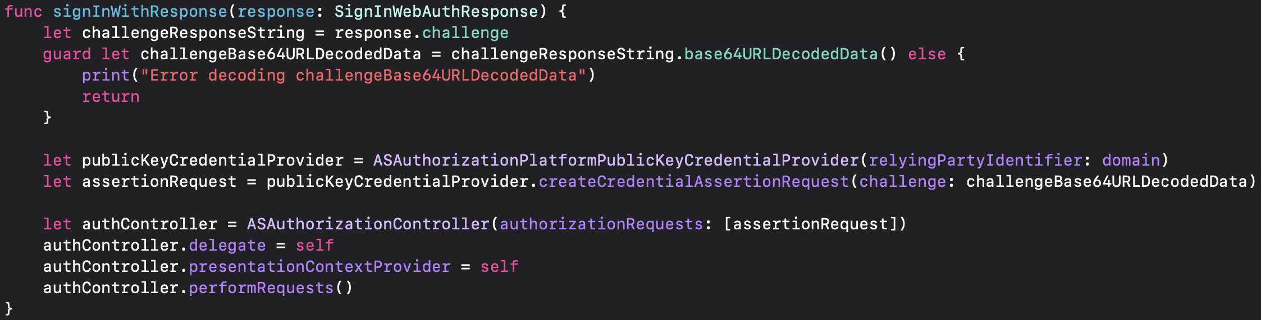
Sign in

Slide 24




WebAuthn Setup
Install Vapor
Install Docker
Install ngrok
Real iPhone device + Provisioning Profile

Slide 25
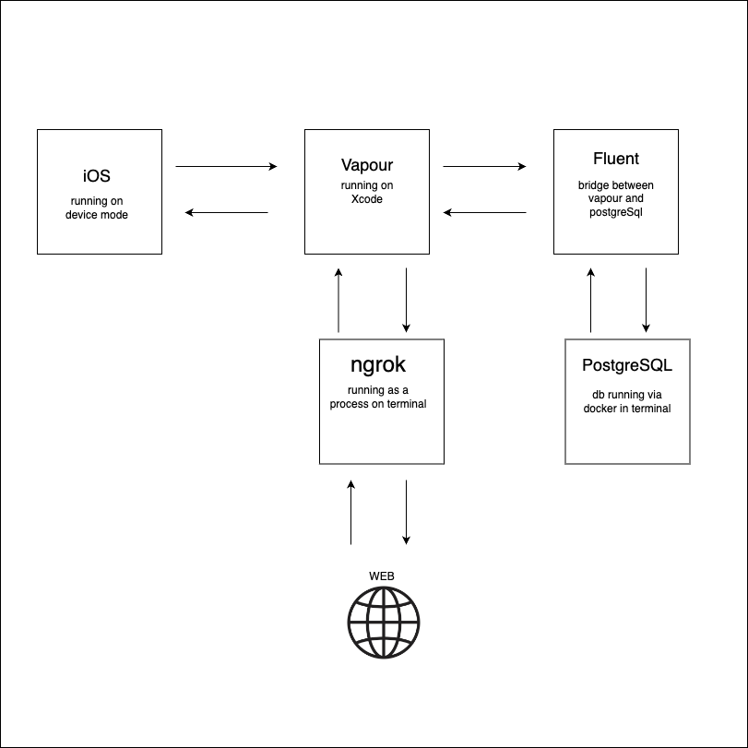
Notes:
Vapor: This is server side application which is running on Xcode.
Ngrok is used to route the request on a given domain on web to the local host on running machine
We check in browser with given domain everytime
Ngrok generates a dynamic domain everytime we update in source code

Slide 26
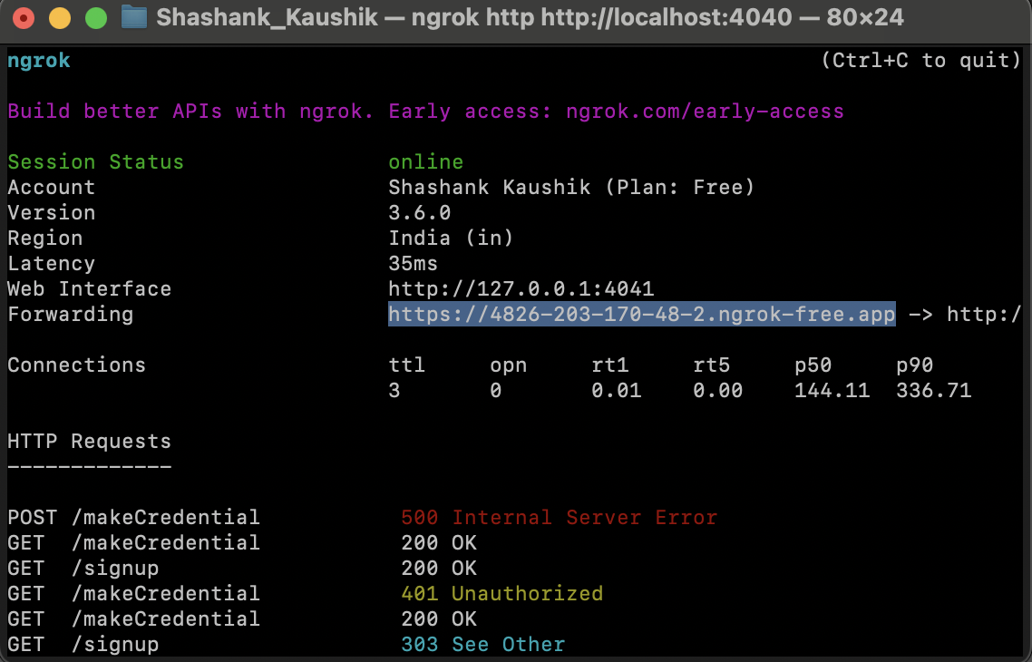
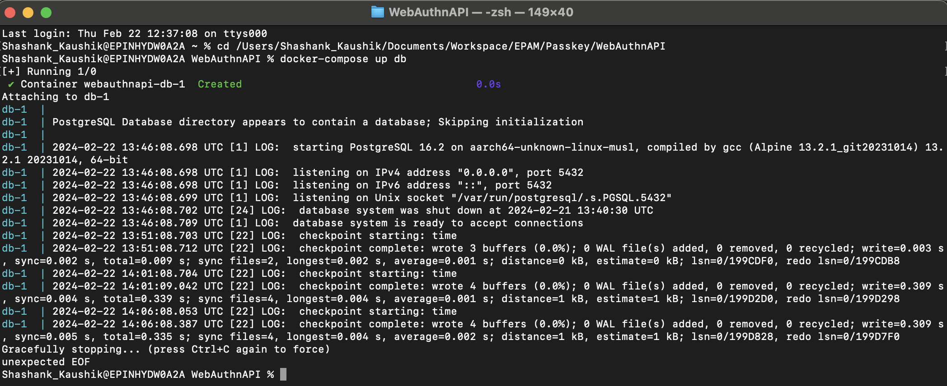
ngrok
database

Slide 27
Challenegs

Slide 28
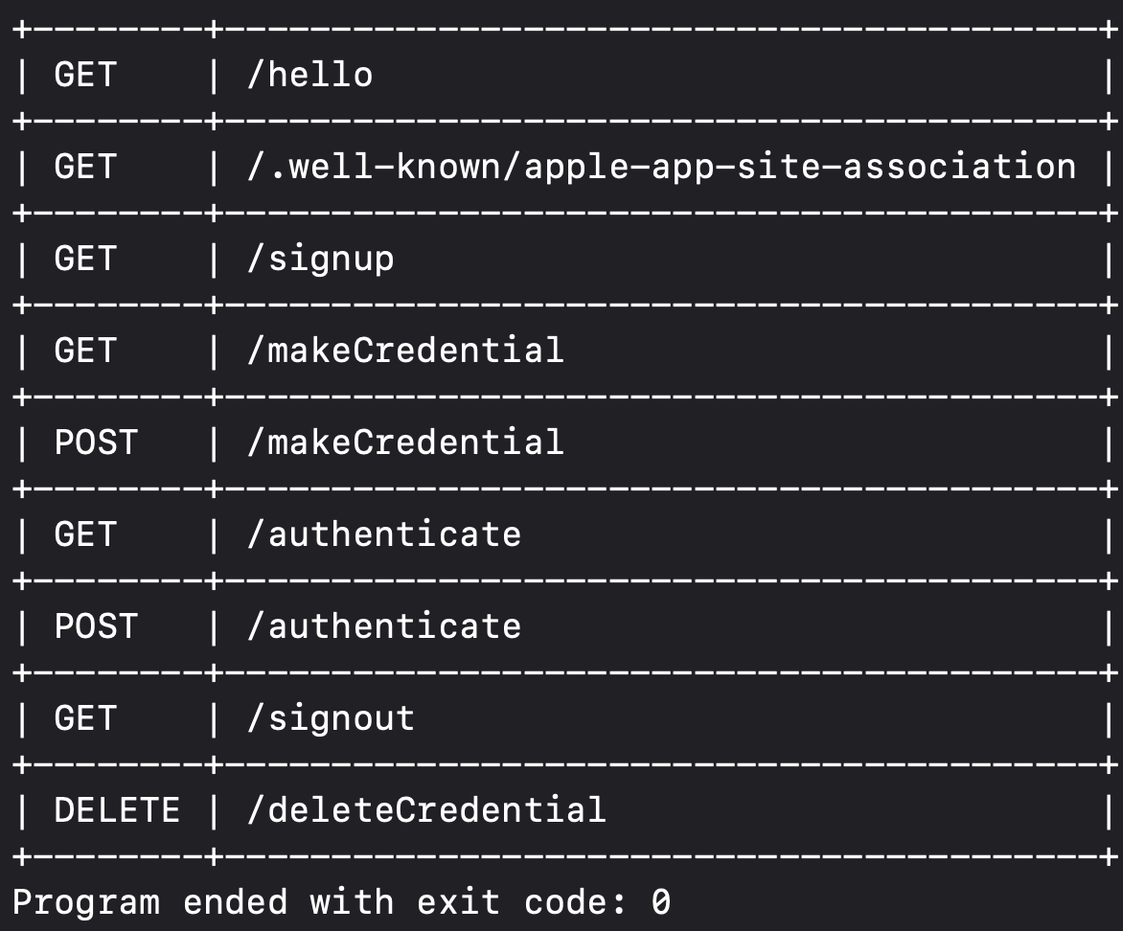
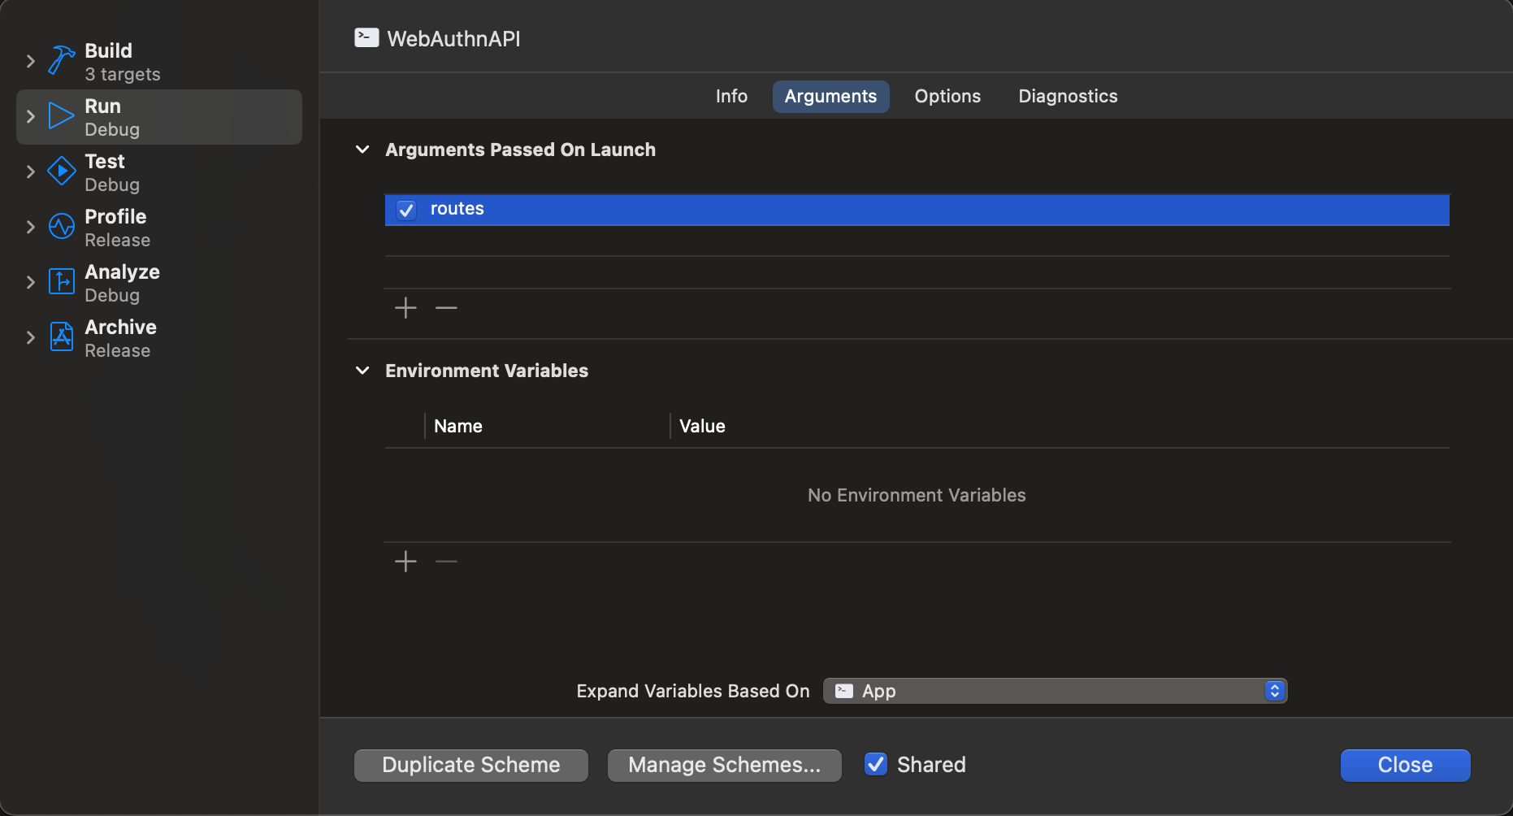
Challenge–1
Challenge
Solution
Check if all Endpoints are working
Pass environment variable “routes”

Slide 29
Challenge–2
Challenge
Solution
Port already used
Quit the Process by PID or attach debugger to running process

Slide 30
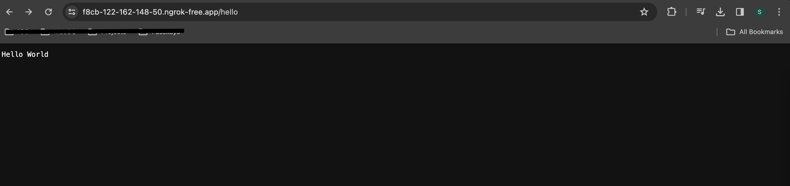
Challenge–3
Challenge
Solution
Check if vapor/server running
Write hello endpoint which return response
Check in browser

Slide 31
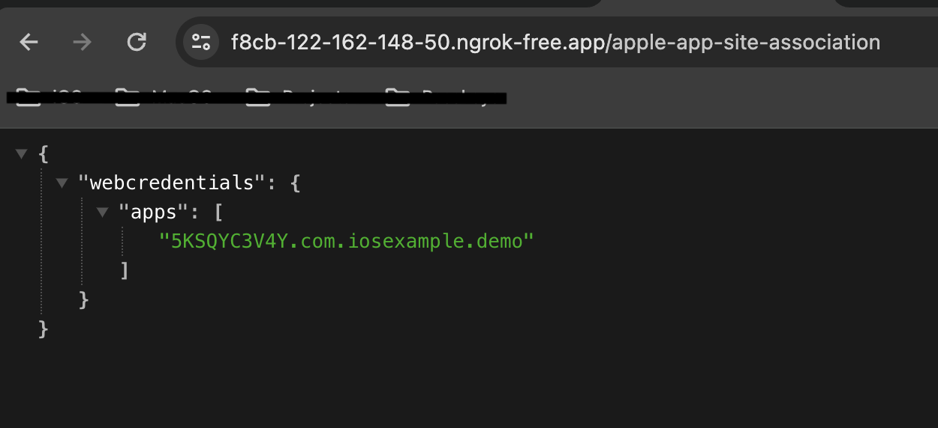
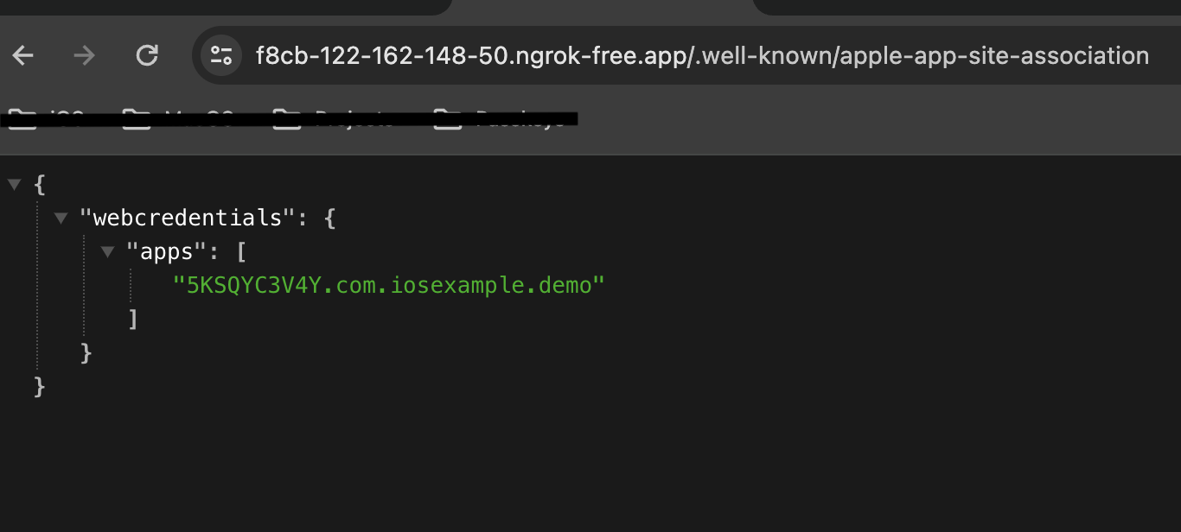
Challenge–4
Challenge
Solution
Check if both are accessible
- apple-app-site-association
- .well-known/apple-app-site-association

Slide 32
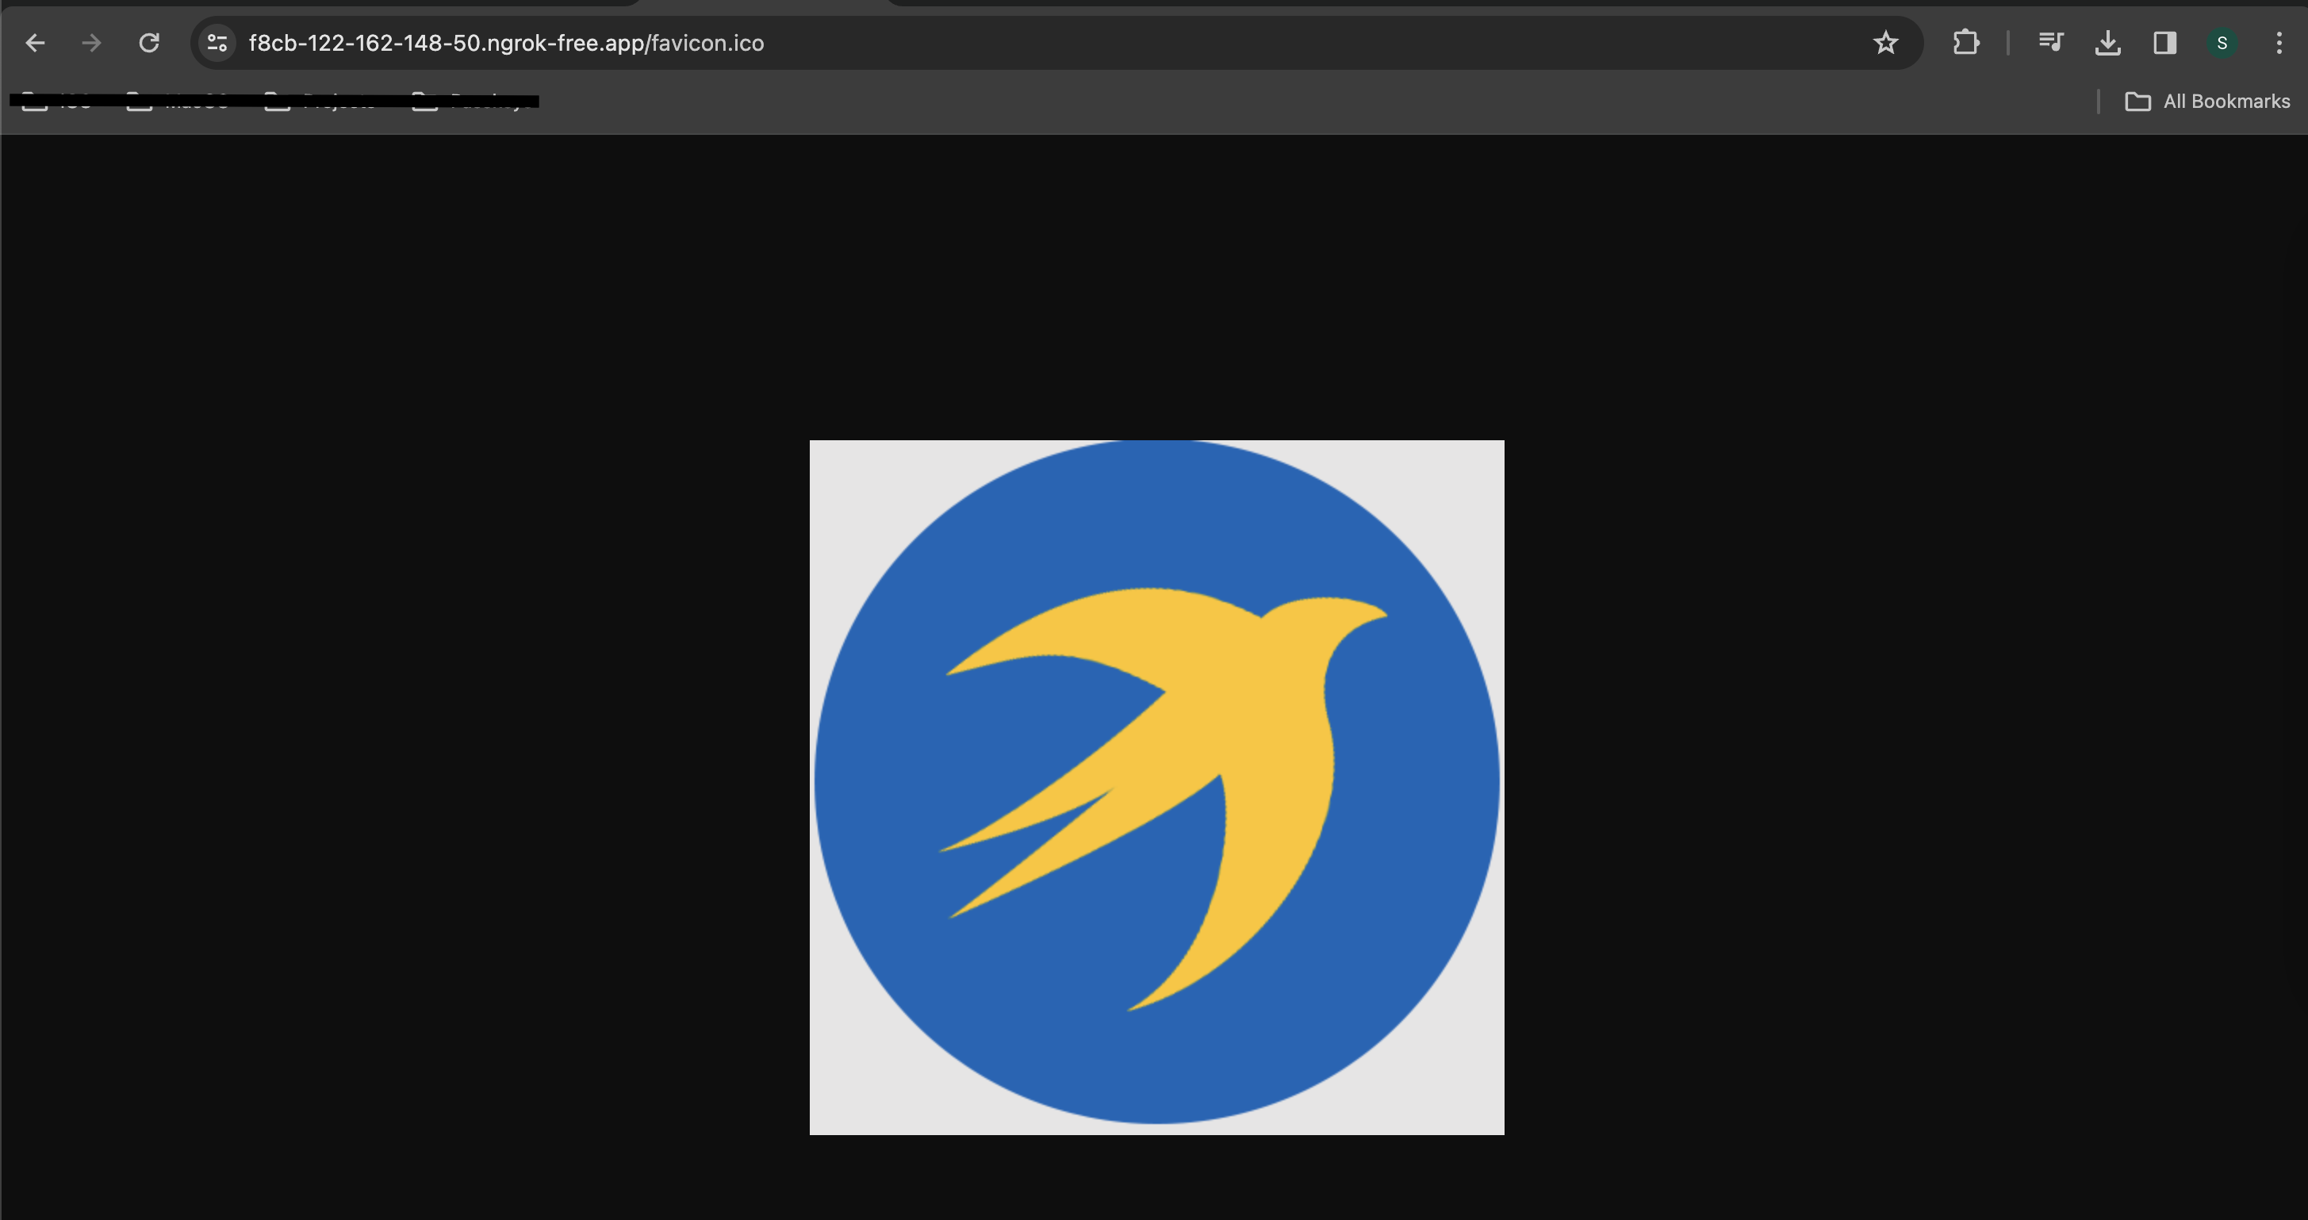
Challenge–5
Challenge
Solution
Check if favicon.ico is accessible

Slide 33
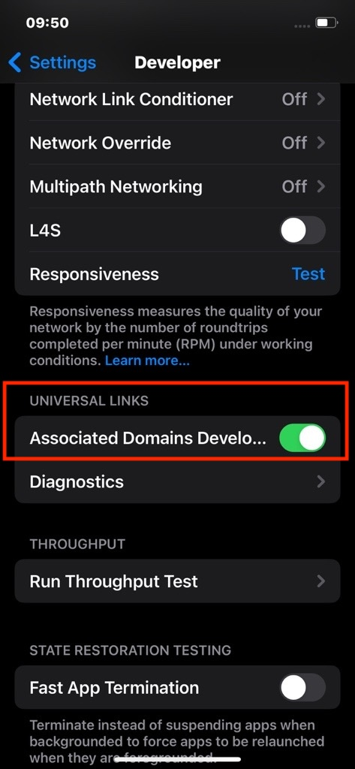
Challenge–6
Challenge
Enable Associated Domains Development

Slide 34
Challenge–7
Challenge
Solution
Run on device
Provisioning Profile with capability of Associated domain

Slide 35
Takeaways
Multi-Platform
Easily Integrated
Secured in many ways
Easy and Fast for user to login

Slide 36
Q&A

Slide 37
Thank You

